Slide 1

English for Information Technology
Dept of information management, Yuanze University
Week
3

Slide 2

BBC Learning English

Slide 3
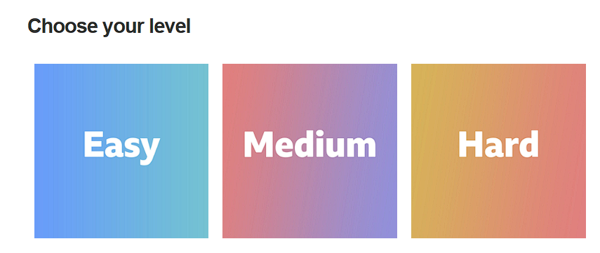
BBC Learning English

Slide 4
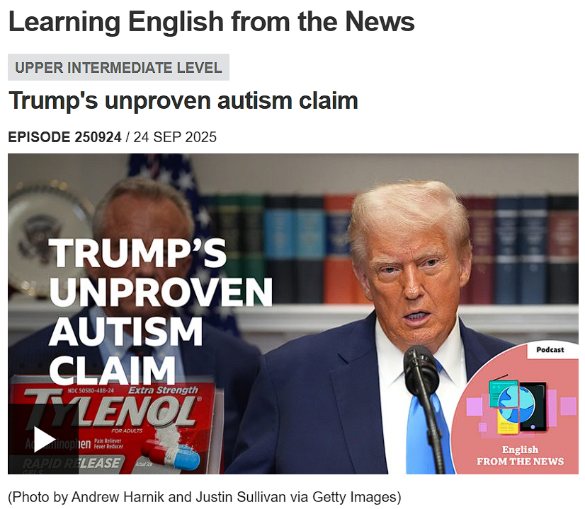

BBC Learning English

Slide 5
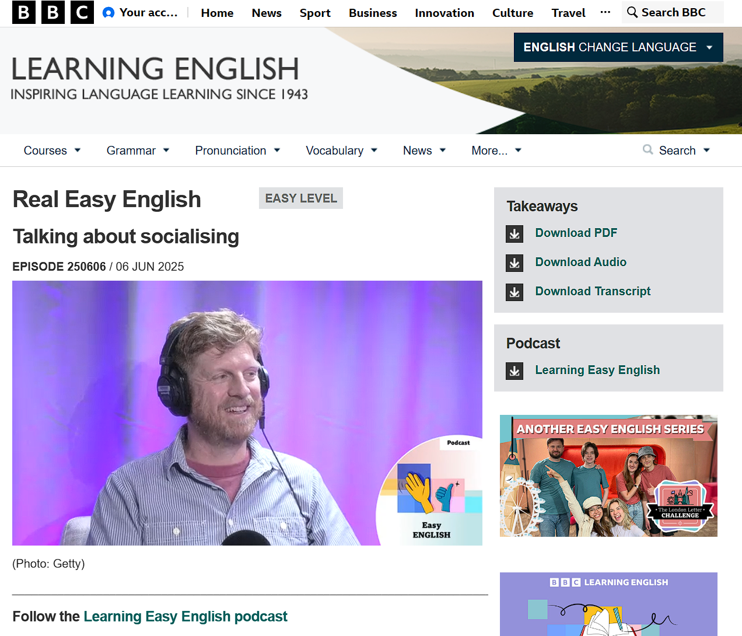

Online resources for today
Original Article

Slide 6
Listen
Two persons, two views
Neil and Georgie have a real conversation in easy English about
spending time with friends.
Learn to talk about what you do with your friends and whether you like socialising.

Slide 7
Vocabulary
socialise
Definition: spend time with people for fun, like friends or family.
Example: "I love to socialize with my friends on weekends."
small talk
Definition: conversation about unimportant things, like the weather, usually with people you don't know well
Example: "Neil doesn't like small talk because he finds it empty."
awkward
Definition: Feeling uncomfortable or strange in a situation, especially when meeting new people.
Example: "Neil finds small talk awkward."
embarrassed
Definition: Feeling ashamed or uncomfortable, often because of something you did or said.
Example: "Sometimes Neil feels embarrassed when he doesn't find something in common with new people."
Grown-ups
Definition: Adult people, not children.
Example: "Grown-ups often have many responsibilities, like work and family."
have (something) in common
Definition: share the same interests, likes or dislikes
Example: "If you find something in common with someone, it's easier to talk."
Social burnout
Definition: Feeling very tired and exhausted because you have spent too much time with other people.
Example: Georgie sometimes experiences social burnout after many social plans.
Recap
Definition: To summarize or repeat the main ideas or points of something.
Example: "At the end of the podcast, Neil and Georgie recap the new vocabulary."

Slide 8
Speak
1. The podcast speaks about getting social burnout and needing time alone. Which do you prefer: spending time alone to relax and get energy, or hanging out with friends?
2. How do you feel if you are alone for too long?
3. When socializing, do you prefer big parties because you like meeting new people and dancing, or do you prefer smaller social events where you can have "deeper conversations" with fewer people?
4. Do you like engaging in small talk, or do you find it awkward when you talk to people you don't know very well?
5. How do you start conversation when you meet someone new?
6. What are some of your strategies to avoid embarrassment?
7. How quickly do you usually try to find something in common with a new person to start a conversation?

Slide 9
Takeaway
The Great Debate | Big Parties | Small Gatherings
Meeting New People | Excitement | Awkwardness
Finding Your Energy | Alone Time | Social Time
It is completely normal for people to have different preferences for socializing.
Some people, like Georgie, enjoy big parties and meeting new people, while others, like Neil, prefer smaller, more familiar groups.
This conversation is a perfect example of how to politely share and contrast personal opinions in a friendly, natural way in English.

Slide 10

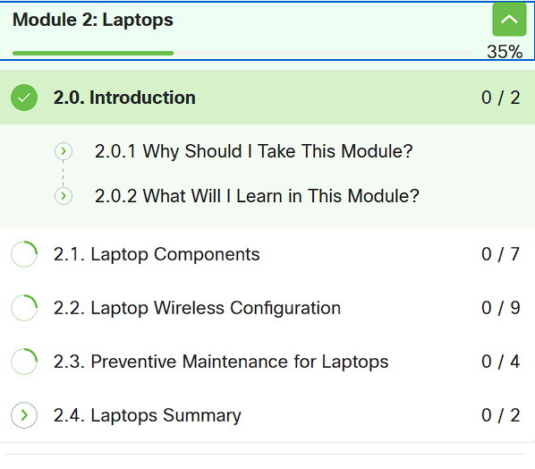
Update on CN Academy
Cisco Networking Academy: Computer Hardware Basics

